Slide 1

MetLife Policy Surrender Case Study
Celina Alnakib
August 12, 2025

Slide 2
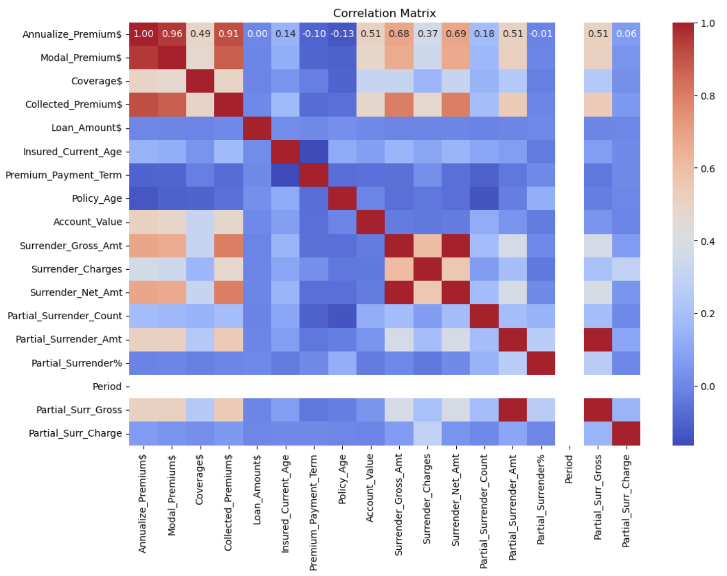
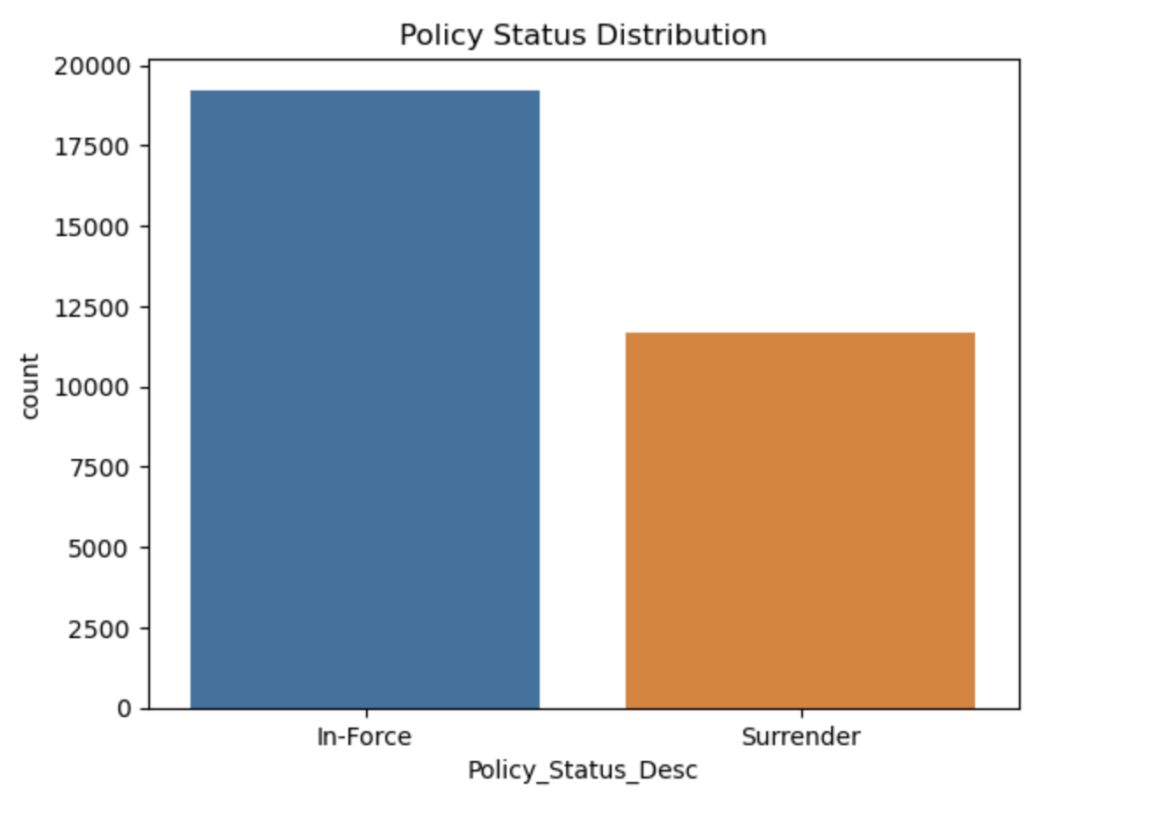
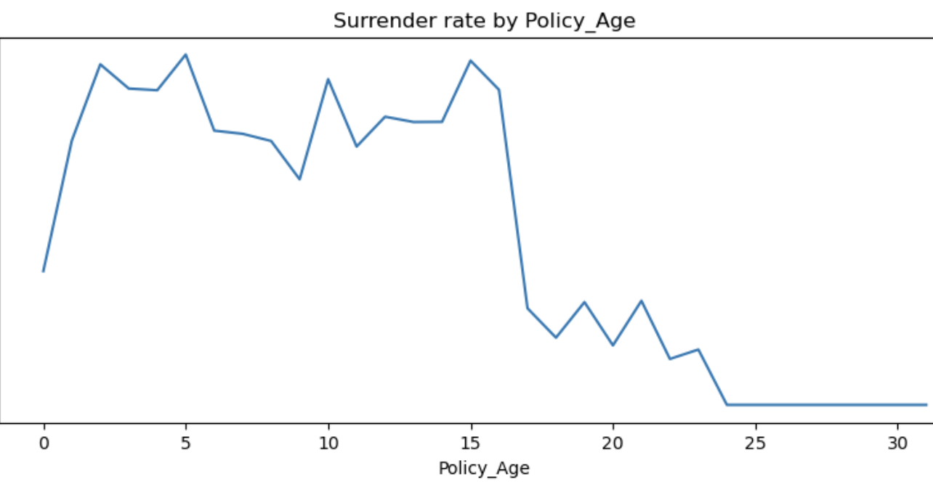
Exploratory Data Analysis (EDA)
Notes:
Partial Surrender Takeaways
Partial Surrender Notes
1. Channel Targeting:
- BANCA and AGENCY channels account for over 93% of partial surrenders.
- Targeted retention campaigns for these distribution channels could significantly reduce surrender rates.
2. Geographic Focus:
- UAE and Qatar together represent 84.6% of partial surrenders.
- Region-specific interventions (e.g., localized offers, customer service enhancements) may have an outsized impact.
3. Product-Specific Risk:
- "Investor Booster" product alone accounts for nearly 40% of partial surrenders.
- Review product terms, communication, and suitability assessments for high-risk products.
4. Payment Mode Insight:
- Annual and monthly payment modes together cover 86.4% of partial surrenders.
- Payment flexibility or alternative billing options could improve retention for customers struggling with cash flow.
5. Retention Segmentation Potential:
- Combining high-risk channels, geographies, products, and payment modes can form a focused "High-Risk Surrender" segment for predictive modeling.
- This segmentation enables prioritization of retention resources for maximum ROI.

Slide 3
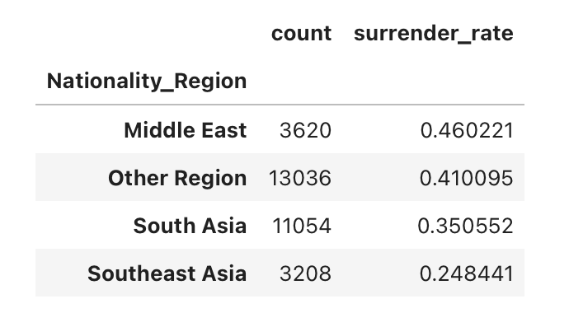
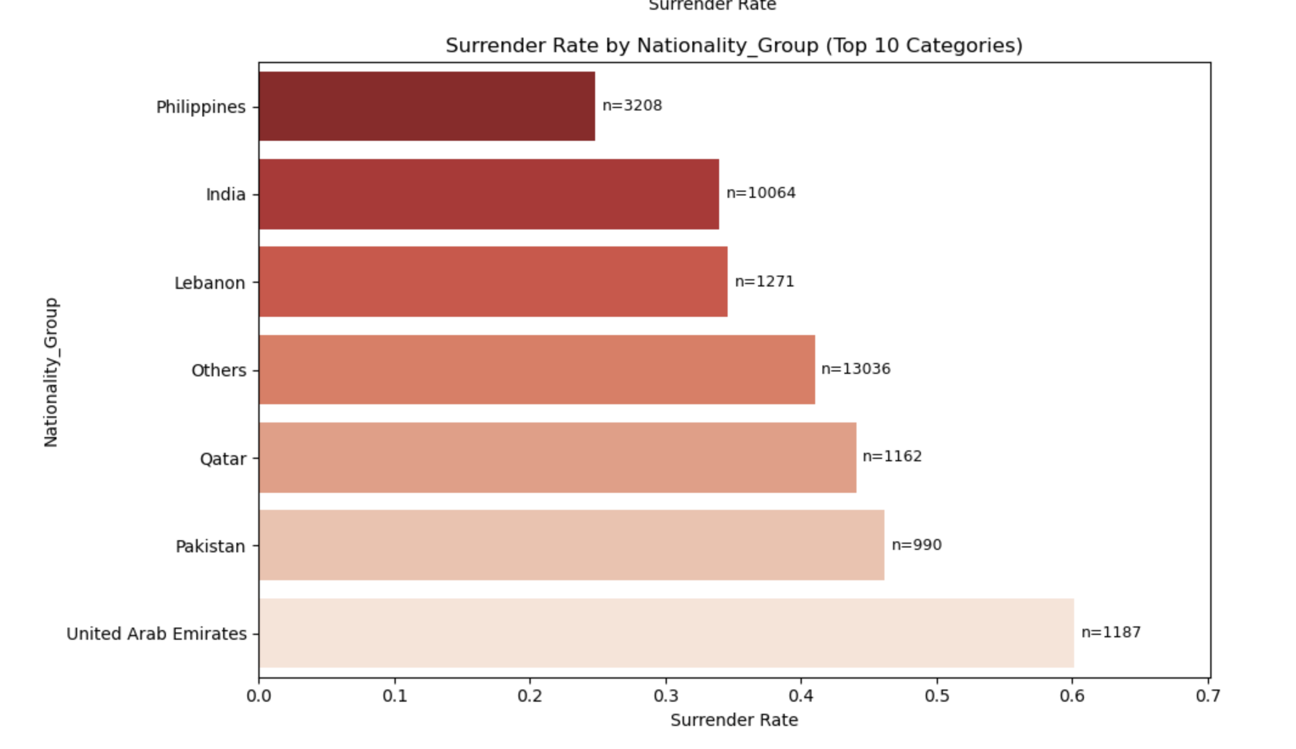
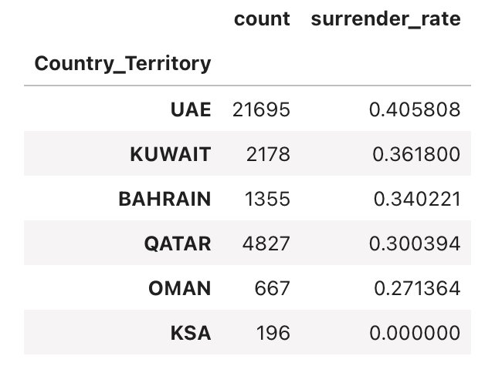
Data Overview
Notes:
Target Variable
- Policy_Status_Desc: `In-Force` (62%) vs `Surrender` (38%).
- This is reasonably balanced for classification — no need for oversampling/undersampling at this stage.
Categorical Features (High Cardinality & Low Cardinality)
- High cardinality: `Partner_Name`, `Plan_Code`, `Product_Code`, `Nationality` → may require target encoding or grouping low-frequency categories.
- Low cardinality: `Channel`, `Country_Territory`, `Payment_Mode`, `Gender` → can use one-hot encoding.
Feature Distribution Observations
- `Channel` distribution: BANCA (55%) dominates; AGENCY (38%).
- `Country_Territory`: UAE (70%) majority — risk of location bias.
- `Nationality`: Top 5 nationalities account for 60% of data.
- `Payment_Mode`: Monthly most common (57%).
- `Premium_Type`: Majority are `Regular Premium`.

Slide 4
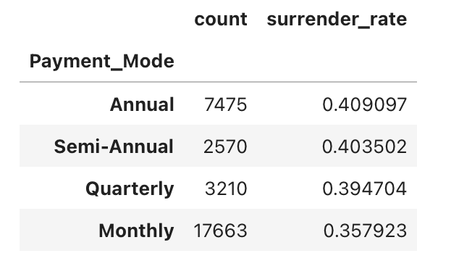
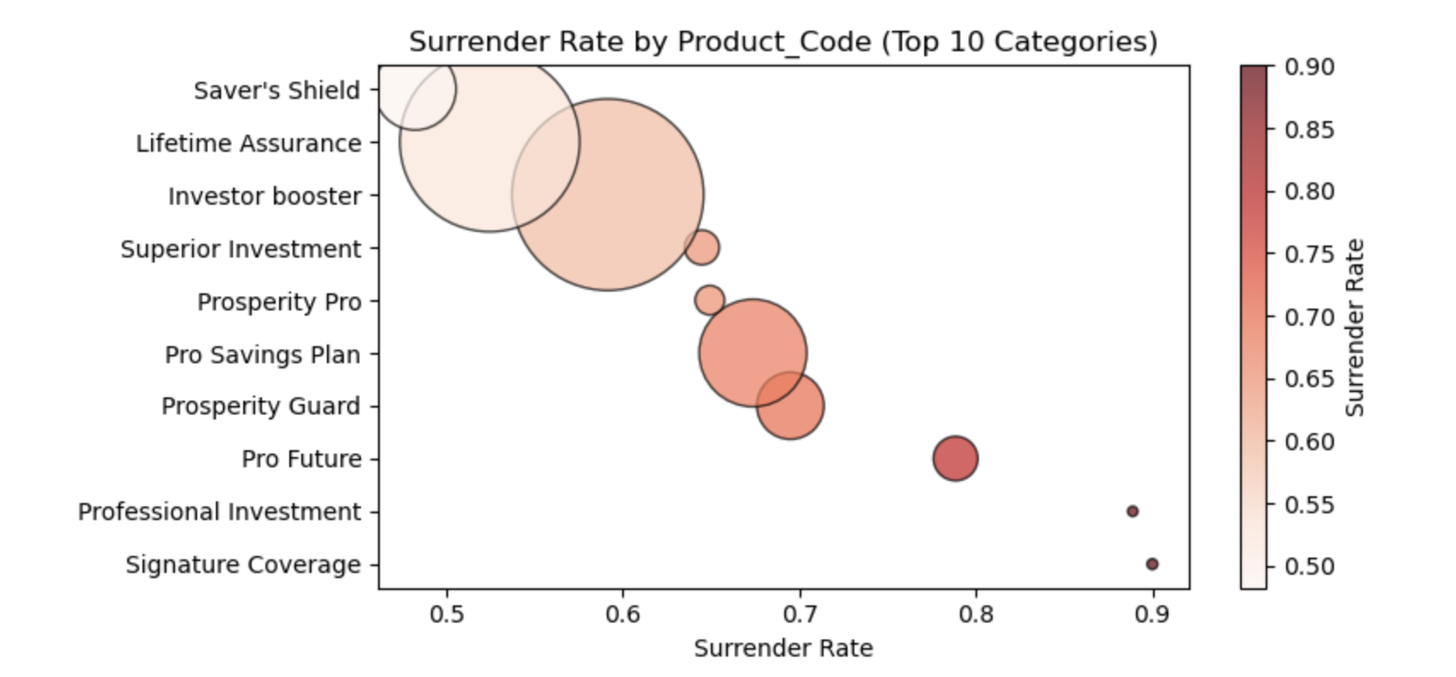
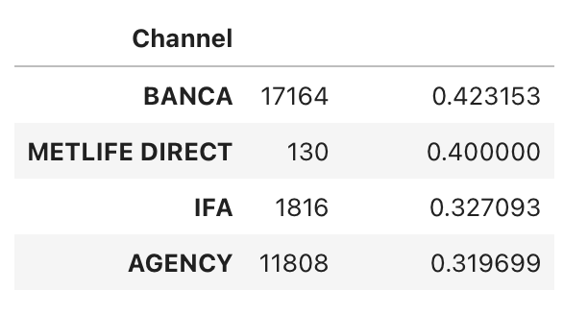
Data Overview
Notes:
Target Variable
- Policy_Status_Desc: `In-Force` (62%) vs `Surrender` (38%).
- This is reasonably balanced for classification — no need for oversampling/undersampling at this stage.
Categorical Features (High Cardinality & Low Cardinality)
- High cardinality: `Partner_Name`, `Plan_Code`, `Product_Code`, `Nationality` → may require target encoding or grouping low-frequency categories.
- Low cardinality: `Channel`, `Country_Territory`, `Payment_Mode`, `Gender` → can use one-hot encoding.
Feature Distribution Observations
- `Channel` distribution: BANCA (55%) dominates; AGENCY (38%).
- `Country_Territory`: UAE (70%) majority — risk of location bias.
- `Nationality`: Top 5 nationalities account for 60% of data.
- `Payment_Mode`: Monthly most common (57%).
- `Premium_Type`: Majority are `Regular Premium`.

Slide 5
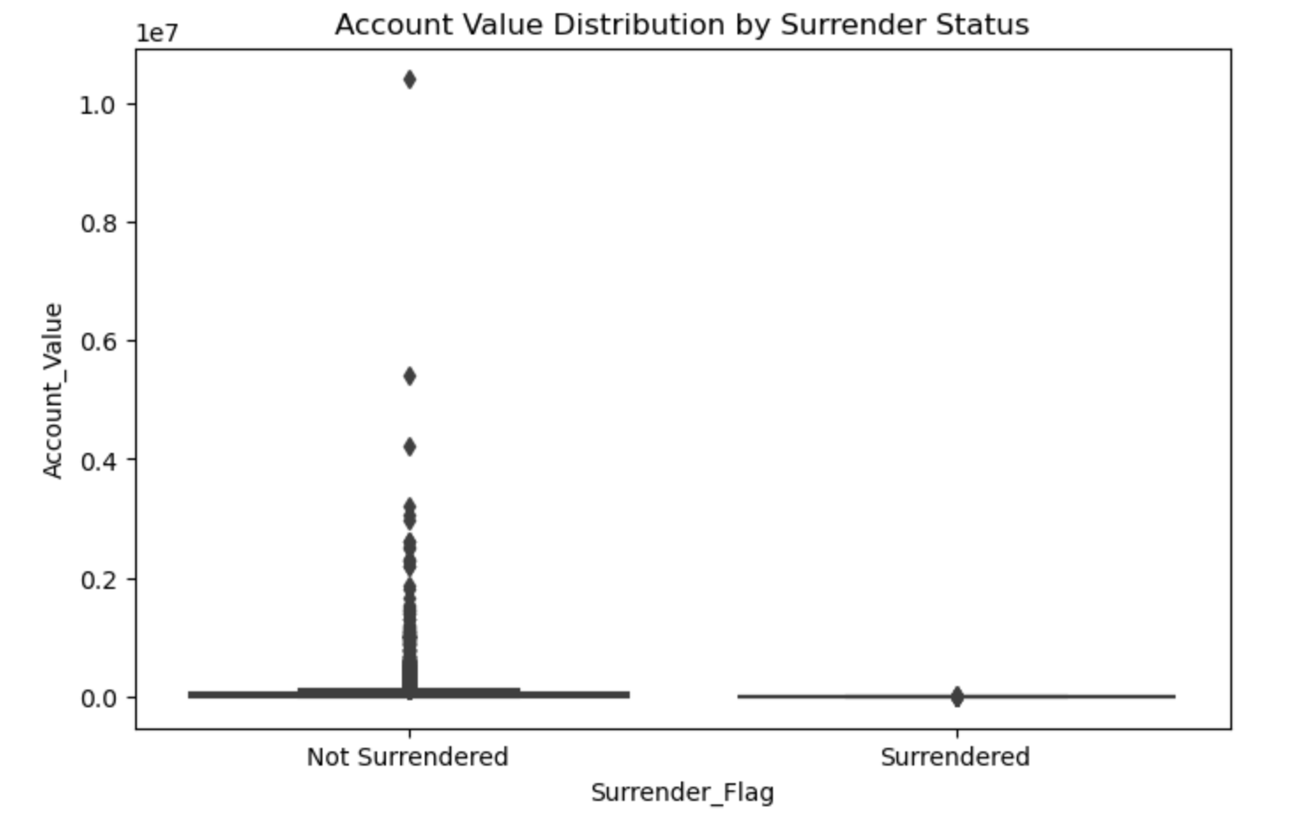
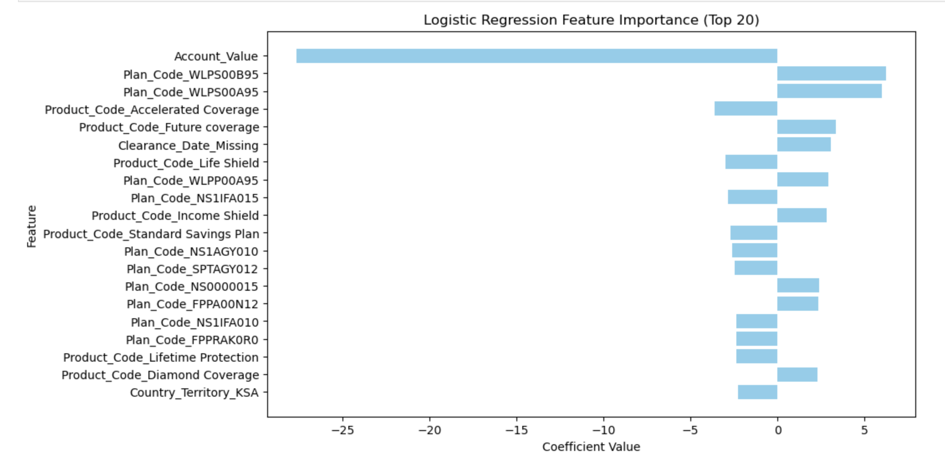
Logistic Regression Features
Account Value: Retention strategies should focus less on high-account-value policies, and more on customers with lower balances.
Plan_Code_WLPS00B95 (6.24) & Plan_Code_WLPS00A95 (5.99): These plans may have terms, benefits, or customer segments that predispose them to higher surrender risk. Review the terms, pricing, and customer demographics for these products; design targeted retention offers.
Product_Code_Accelerated Coverage (-3.60): Possibly perceived as valuable protection — customers tend to hold onto it. This product type could be promoted to high-risk customers as an upsell or bundle.
Product_Code_Future coverage (3.36): May not be meeting customer expectations over time. Review product features and customer feedback; consider redesign or loyalty incentives.
Clearance_Date_Missing (3.07): This could reflect poor data entry, incomplete onboarding, or customer disengagement early in the policy lifecycle. Improve data collection and follow-up processes.
Notes:
How to Improve the Logistic Regression Model
Make features more meaningful
Combine important features to capture how they interact (e.g., account value × product type).
Transform numeric features that are very skewed to make patterns clearer.
Group similar categories together to simplify the data and reduce noise.
Handle class imbalance
Since fewer policies are surrendered, consider weighting classes or oversampling to make the model better at predicting surrenders.
Adjust the cutoff for deciding a policy is “at risk” to catch more high-risk policies.
Regularize the model
Use techniques like L1 (Lasso) or Elastic Net to reduce overfitting and focus on the most important features.
Tune model parameters using cross-validation to find the best balance.
Evaluate more comprehensively
Use lift and gain charts to see how well the model identifies the highest-risk policies.
Test the model across different groups (products, channels, countries) to make sure it works consistently.
Include business-specific signals
Add features that reflect customer behavior, like how long since their last payment or how far along a policy is.
Keep an eye on features that may change over time (like account balances) to ensure predictions remain accurate.
Make the model explainable
Use SHAP or LIME to understand why the model predicts a policy is likely to surrender.
Investigate any surprising feature impacts—these can reveal business insights.
Keep improving
Test the model on new policy cohorts to make sure it stays accurate.
Consider combining it with tree-based models if you want even better predictions.
Feature Impact Interpretation
Account_Value (-27.64)
Meaning: Higher account values are strongly associated with a lower probability of policy surrender.
Business implication: Customers with significant accumulated account value are less likely to surrender — possibly because they have more to lose in penalties or future benefits.
Action: Retention strategies should focus less on high-account-value policies, and more on customers with lower balances.
Plan_Code_WLPS00B95 (6.24) & Plan_Code_WLPS00A95 (5.99)
Meaning: Policies under these plan codes are substantially more likely to surrender.
Business implication: These plans may have terms, benefits, or customer segments that predispose them to higher surrender risk.
Action: Review the terms, pricing, and customer demographics for these products; design targeted retention offers.
Product_Code_Accelerated Coverage (-3.60)
Meaning: Holding this product type reduces surrender likelihood.
Business implication: Possibly perceived as valuable protection — customers tend to hold onto it.
Action: This product type could be promoted to high-risk customers as an upsell or bundle.
Product_Code_Future coverage (3.36)
Meaning: Higher surrender likelihood.
Business implication: May not be meeting customer expectations over time.
Action: Review product features and customer feedback; consider redesign or loyalty incentives.
Clearance_Date_Missing (3.07)
Meaning: Missing clearance date data correlates with higher surrender likelihood.
Business implication: This could reflect poor data entry, incomplete onboarding, or customer disengagement early in the policy lifecycle.
Action: Improve data collection and follow-up processes.
Product_Code_Life Shield (-2.97)
Meaning: Lower surrender likelihood.
Business implication: Strong perceived value or critical coverage type.
Action: Could be marketed as a retention-friendly product.
Other Notable High-Impact Features
Negative coefficients (e.g., Plan_Code_NS1IFA015, Product_Code_Standard Savings Plan, Country_Territory_KSA) indicate reduced surrender probability.
Positive coefficients (e.g., Product_Code_Income Shield, Product_Code_Diamond Coverage, Plan_Code_NS0000015) indicate increased surrender probability.
General Observations
Magnitude matters: Account_Value’s coefficient is by far the largest in absolute value, making it the strongest predictor.
Plan & Product codes dominate: Many high-importance predictors are plan/product identifiers, suggesting surrender patterns are heavily product-driven.
Geographic factor: Country_Territory_KSA’s negative coefficient suggests location-based behavioral differences — policies in KSA are less likely to surrender.
Data quality indicators: The Clearance_Date_Missing feature shows that missing operational data is a meaningful risk signal.

Slide 6
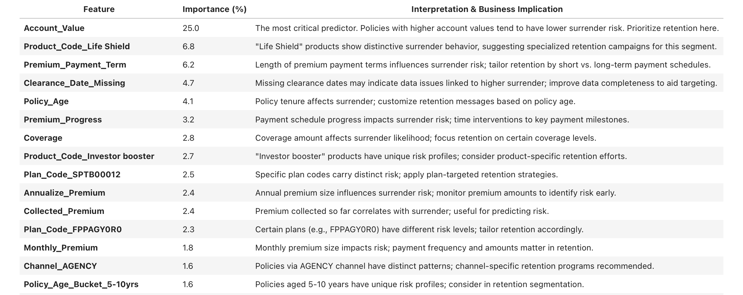
Random Forest Features
Notes:
Summary and Recommendations
- Account Value is the top driver — focus retention efforts on high-value policies to protect revenue.
- Product-level differences suggest tailoring campaigns by product type for greater effectiveness.
- Payment term, payment progress, and policy age highlight critical timing factors for retention interventions.
- Missing data indicators (e.g., `Clearance_Date_Missing`) reveal data quality issues needing attention to improve targeting accuracy.
- Channel and partner group influences enable finer segmentation for personalized retention strategies.
- Leveraging these insights will help reduce policy surrenders, improve customer lifetime value, and optimize retention resource allocation.

Slide 7
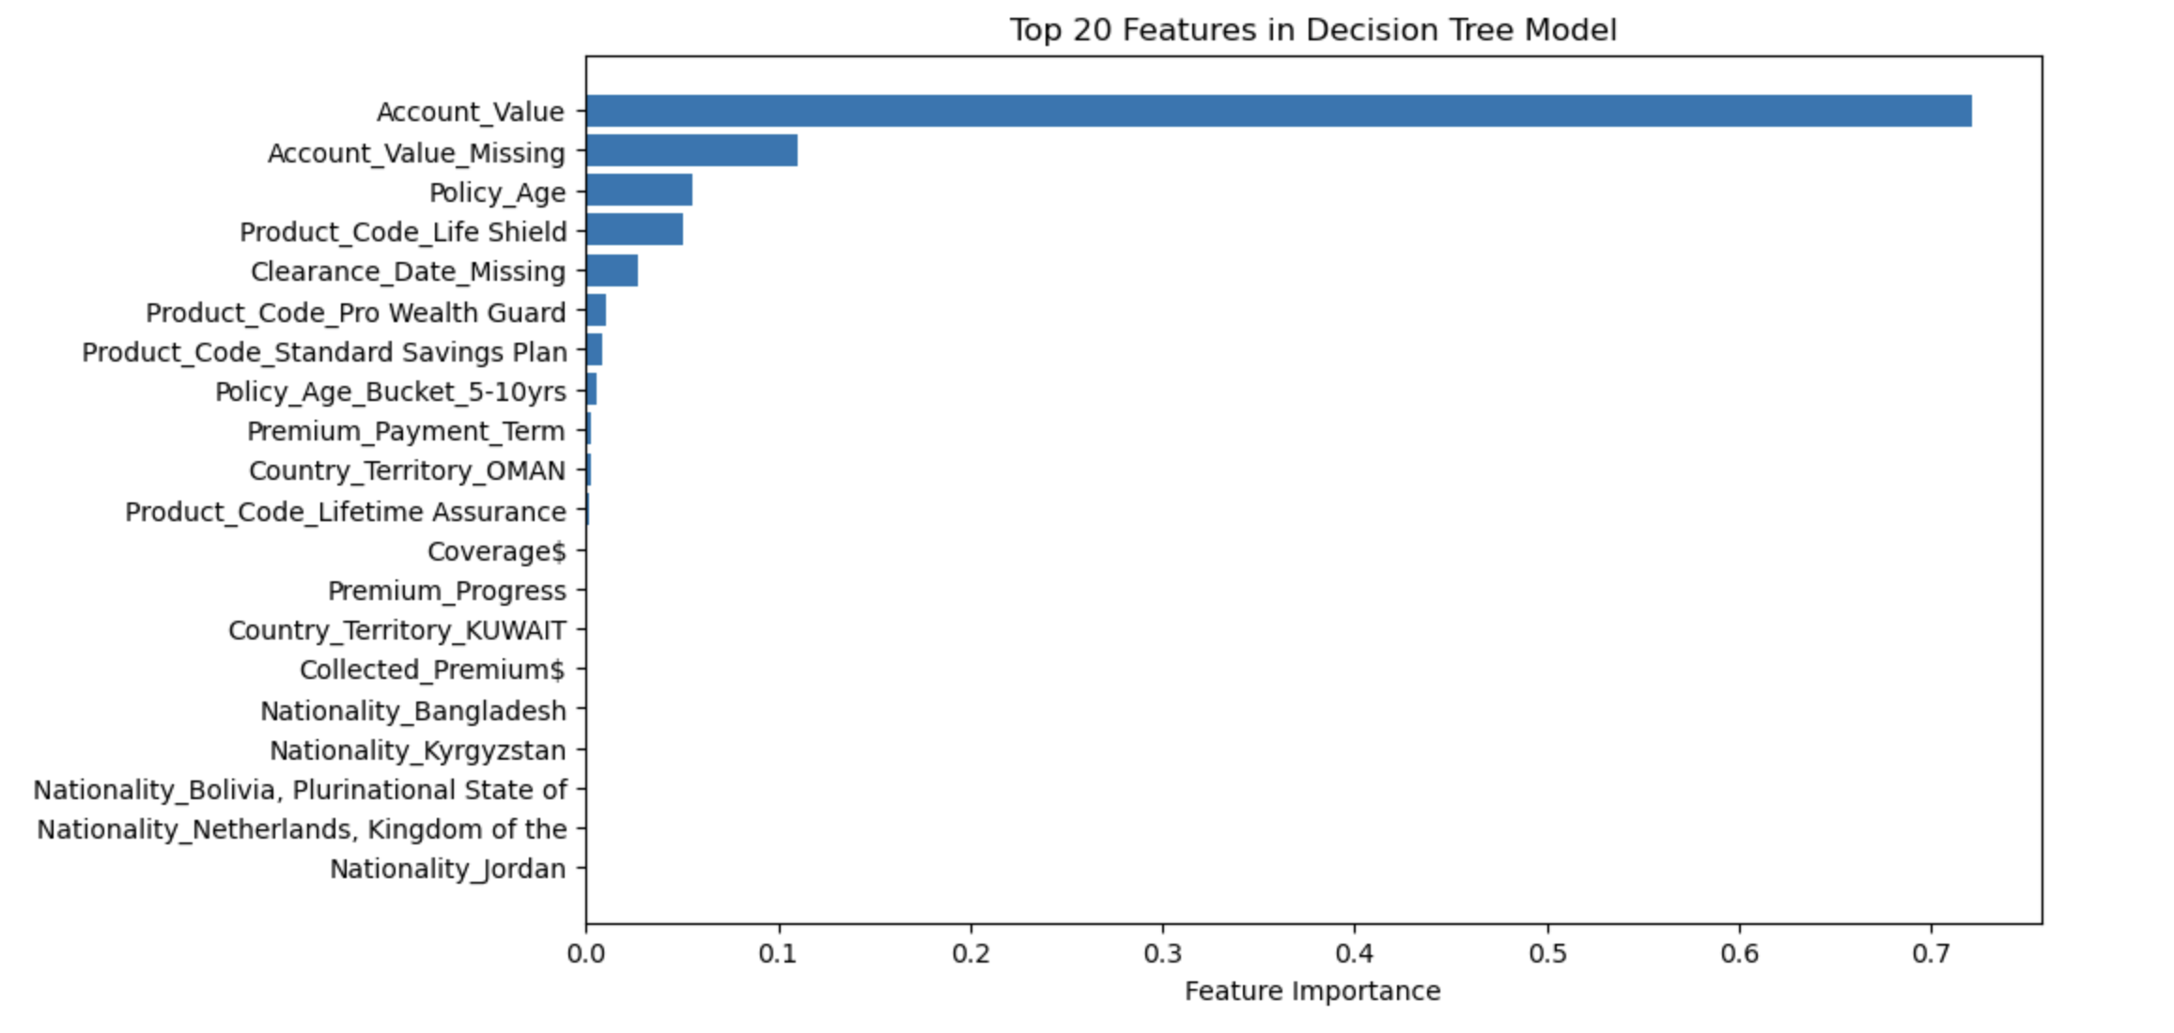
Decision Tree Features
The dominance of Account_Value and missing data flags in the Decision Tree suggests the model relies heavily on financial stake and data completeness as key surrender predictors.
This aligns with business intuition—customers with more invested value tend to stay, and missing or incomplete data often signals higher risk or disengagement.
The model also captures nuances from policy age, product type, and geography, reinforcing the need for tailored, data-driven retention strategies.
Notes:
Suggestions to Improve the Decision Tree Model
Address Data Quality and Missingness
Since missing data flags (e.g., Account_Value_Missing, Clearance_Date_Missing) are highly important, improving data completeness could enhance model accuracy.
Invest in data cleaning, imputation strategies, or even collecting missing information where feasible to reduce reliance on missingness as a proxy.
Feature Engineering Enhancements
Explore creating new composite features that capture interactions, e.g., combining policy age with payment progress or account value with product type.
Incorporate temporal features such as time since last payment or time since last partial surrender to capture recent behavior trends.
Use domain knowledge to add behavioral or engagement metrics, like customer contact frequency or claims history.
Hyperparameter Tuning
Decision Trees are prone to overfitting; tuning parameters like max depth, min samples split, or leaf size could improve generalization.
Use cross-validation with grid or randomized search to identify the best hyperparameters.

Slide 8
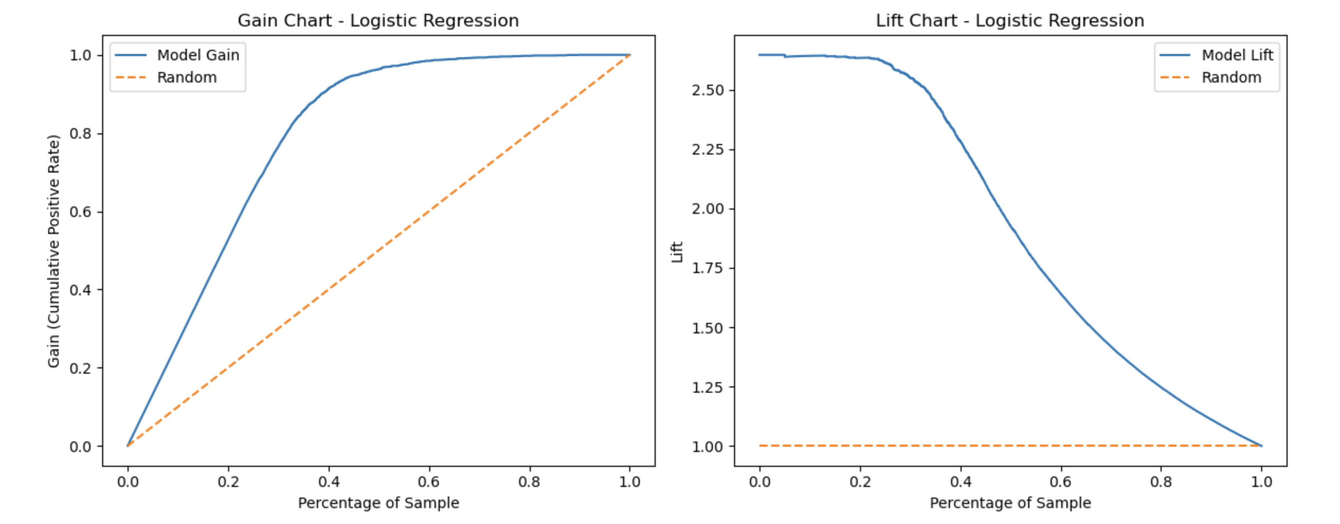
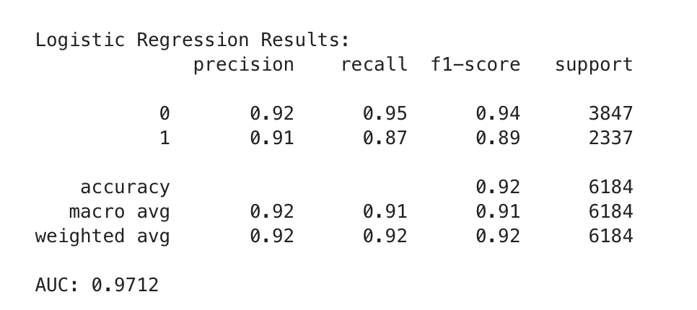
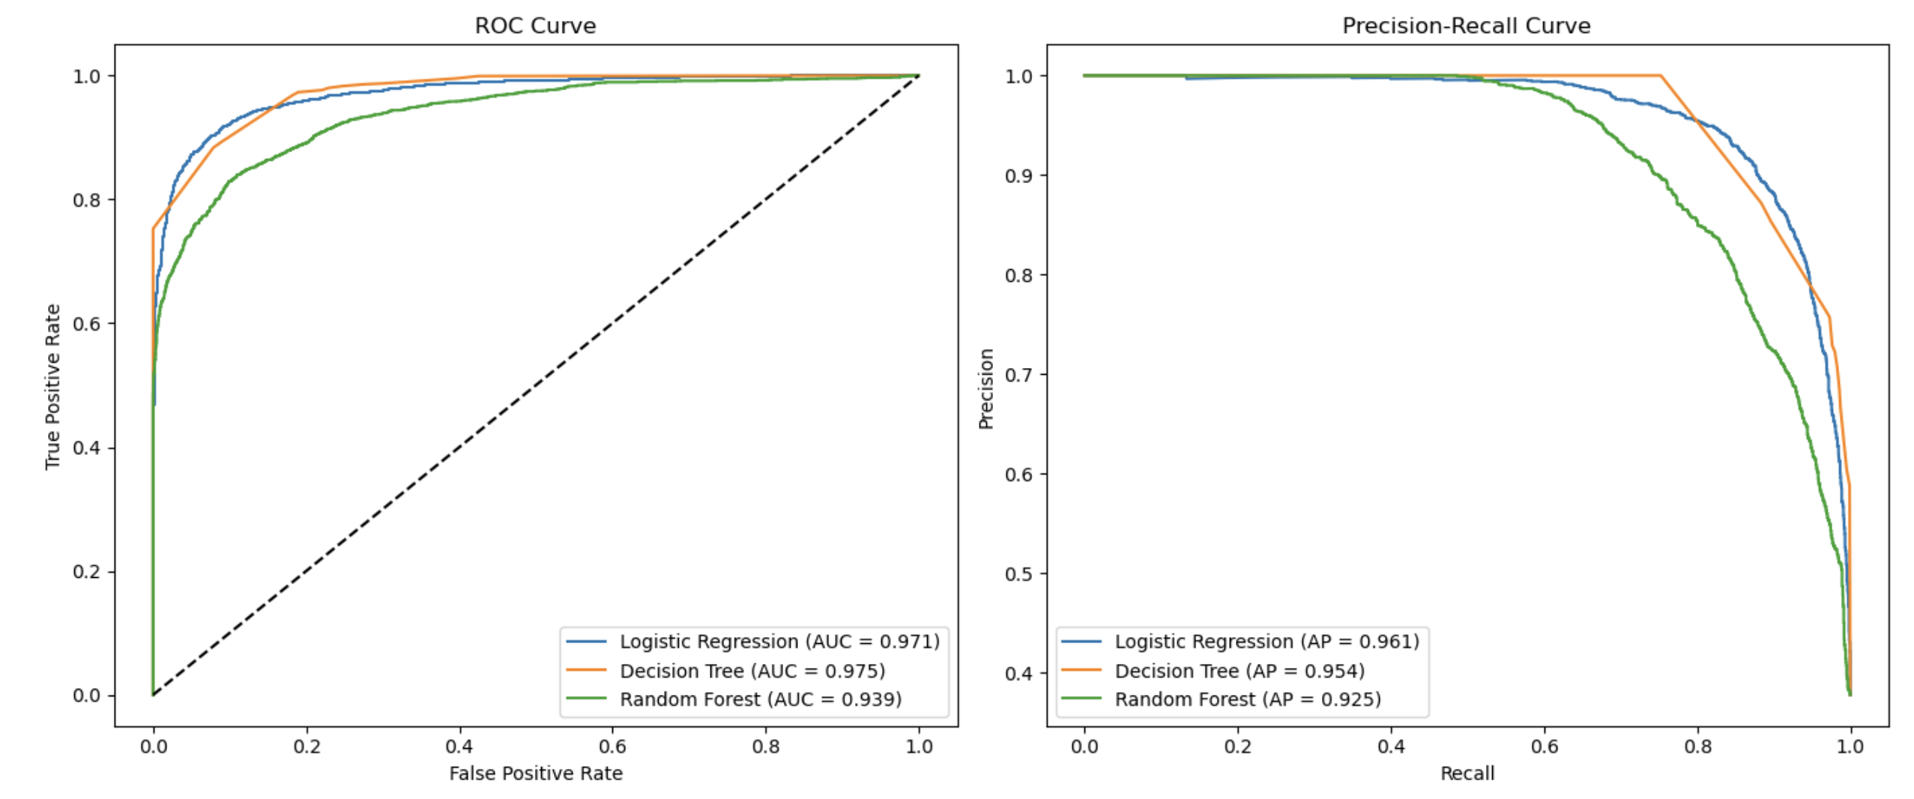
Model Evaluation
Notes:
Logistic Regression
- **Accuracy:** 92%
- **Precision (Surrender = 1):** ~91%
- **Recall (Surrender = 1):** ~87%
- **F1-score (Surrender = 1):** ~89%
- **AUC:** 0.971
**Interpretation:** Logistic Regression provides a strong balance between precision and recall, with excellent overall accuracy and discrimination ability (AUC). It serves as a reliable baseline model with the added benefit of interpretability, making it easy to communicate to business stakeholders.
Decision Tree
- **Accuracy:** 91%
- **Precision (Surrender = 1):** 87%
- **Recall (Surrender = 1):** 88%
- **F1-score (Surrender = 1):** 88%
- **AUC:** 0.9746
**Interpretation:** The Decision Tree slightly improves recall and AUC compared to Logistic Regression, capturing more true surrender cases. It offers straightforward interpretability via decision rules but may require tuning to avoid overfitting (can be a helpful model for interpretability via tree rules)
---
Random Forest
- **Accuracy:** 81%
- **Precision (Surrender = 1):** 100%
- **Recall (Surrender = 1):** 51%
- **F1-score (Surrender = 1):** 67%
- **AUC:** 0.9386
**Interpretation:** The Random Forest achieves perfect precision, meaning all policies flagged as at-risk are true positives. However, it misses a significant portion of actual surrenders (lower recall). This conservative approach can be valuable if false positives are costly but needs further tuning to improve recall and overall accuracy.
---
Note on Class-Balanced Logistic Regression
Including a class-balanced logistic regression can be beneficial to address any class imbalance and potentially improve recall for the minority class (surrender cases). The results for the class-balanced model are very similar to the standard logistic regression though, so we can ignore this.
---
Recommendations
- Use **Logistic Regression** as the main baseline model for its balance and interpretability.
- Use **Decision Tree** for interpretable rules and slightly improved recall.
- Tune **Random Forest** to improve recall without losing precision.

